Slide 1






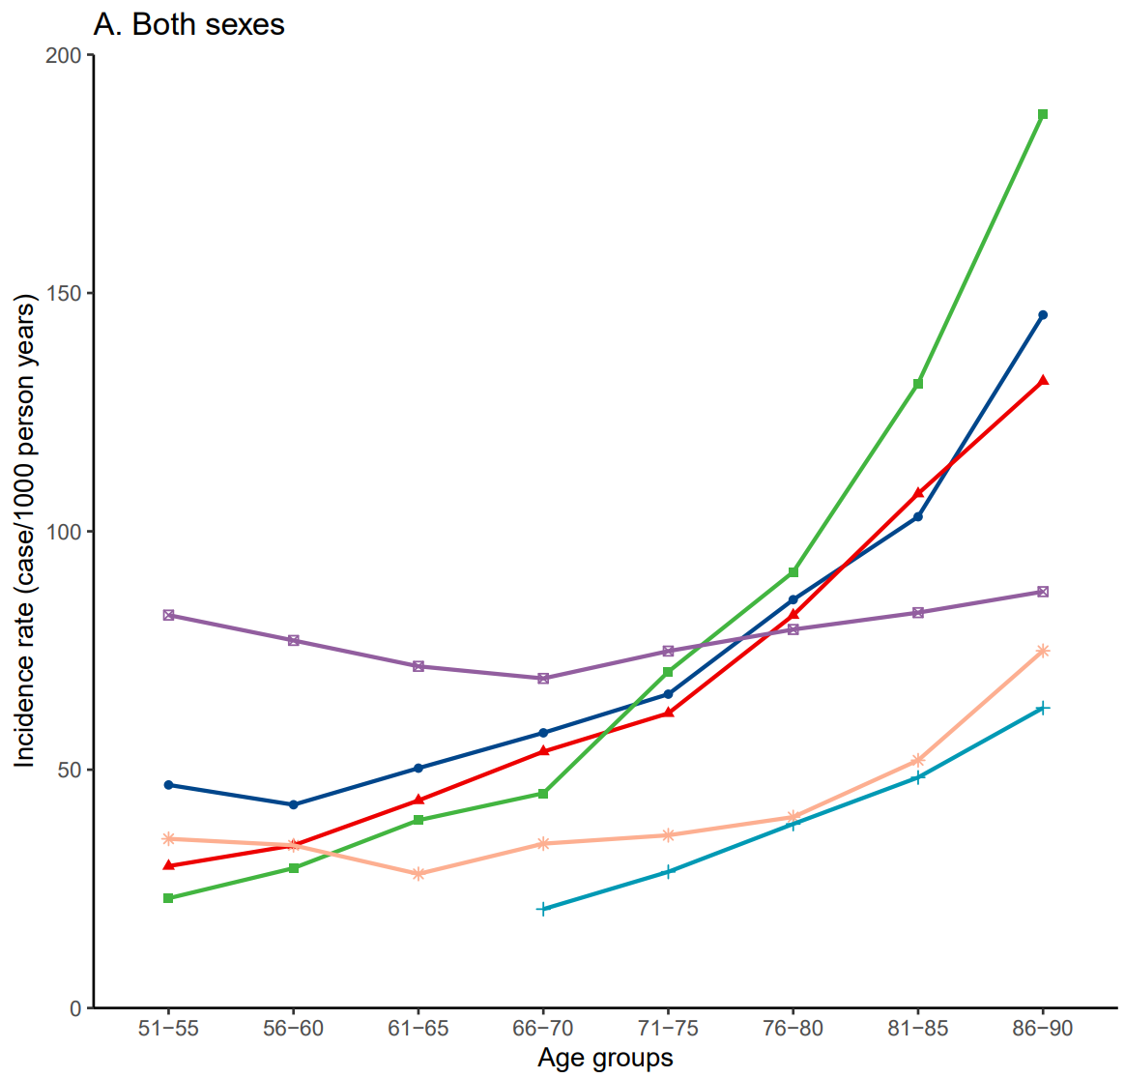
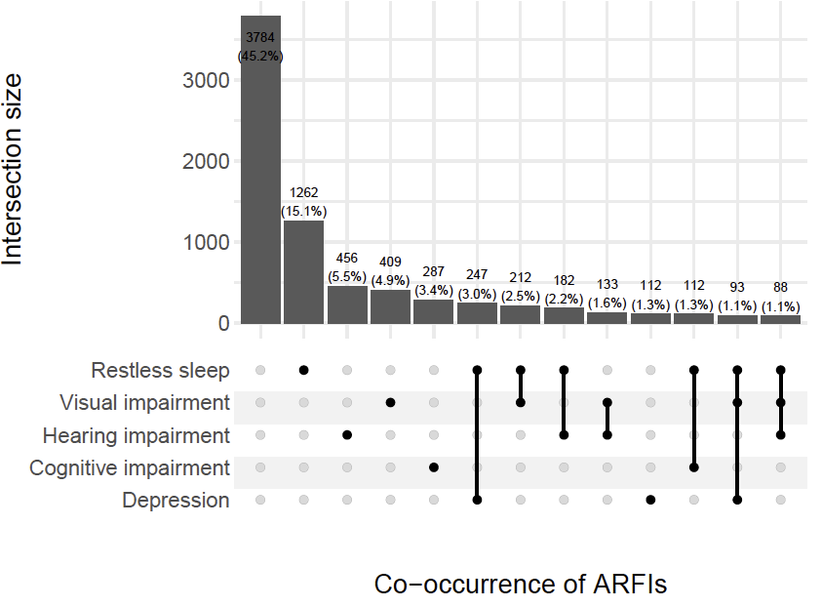
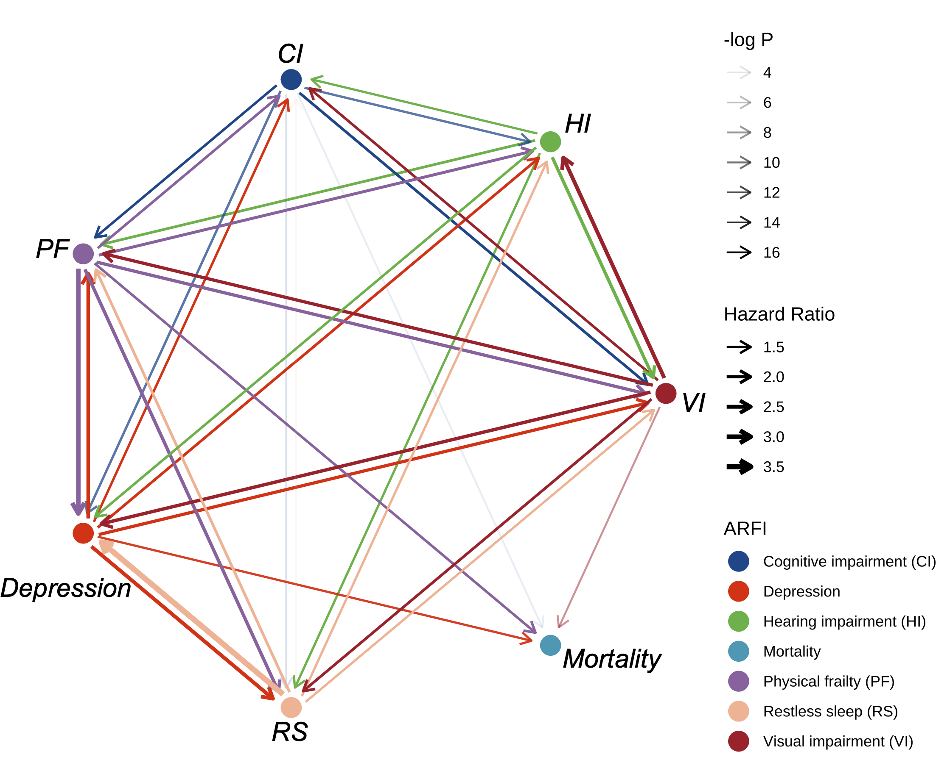
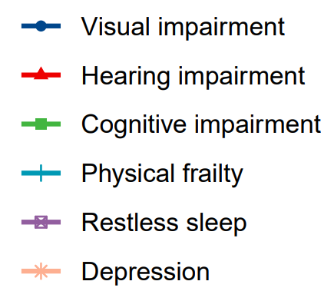
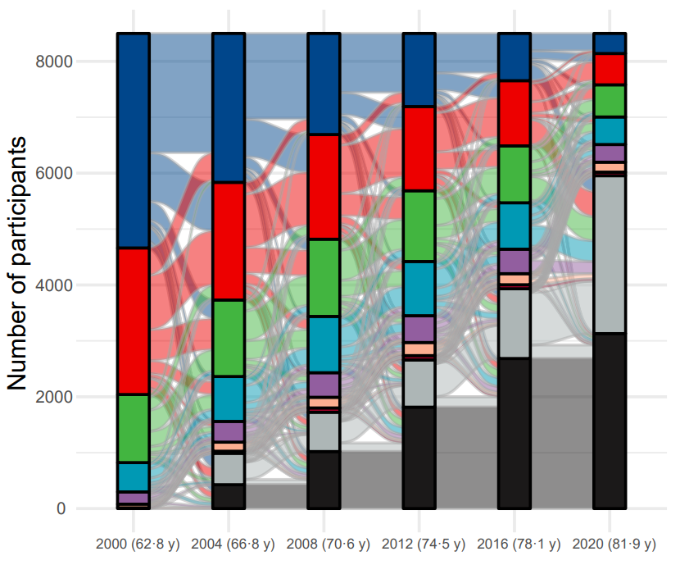
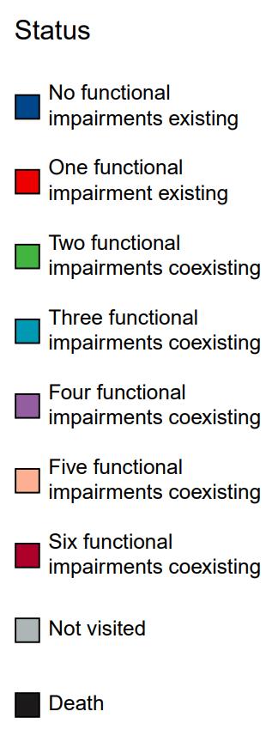
Study design
Functional impairments measured repeatedly for up to 20 years
Restless
Sleep
Visual
Impairment
Hearing
Impairment
2015 born in 1942-1947 from WB
9315 born in 1931-1941 from HRS
2071 born in 1924-1930 from CODA
4513 born before 1924 from AHEAD
2000
Baseline
2002
2004
2006
2008
2010
2012
2014
2016
2018
2020
End of follow-up
Physical
Frailty
Cognitive
Impairment
Depression
Age- and sex-specific incidence
Co-occurrence and progression
Hazard trajectory
Incidence rates of most functional impairments increased exponentially with age (51-90 years).
Incidence rates of restless sleep and depression increased less rapidly with age (51-90 years).
Functional impairments were mutually bidirectionally linked as a network.
Physical frailty, depression, visual impairment, and cognitive impairment independently predicted higher mortality risk.
Functional impairments showed age-specific patterns of co-occurrence and progression.
Chen et al., Progression and trajectory network of age-related functional impairments and their combined associations with mortality

